Slide 1
English Stylistics
Week 14 The Academic Style

Slide 2
In today’s class
Academic style
Guidelines for academic writing
Sentence revision exercises
In-class paragraph writing

Slide 3
Academic writings
The report paper – to summarize and to report
The thesis paper – to evaluate and to discuss
A research proposal – to propose and to justify
A dissertation – a document submitted for an academic degree or professional qualification presenting the author's research and findings.

Slide 4
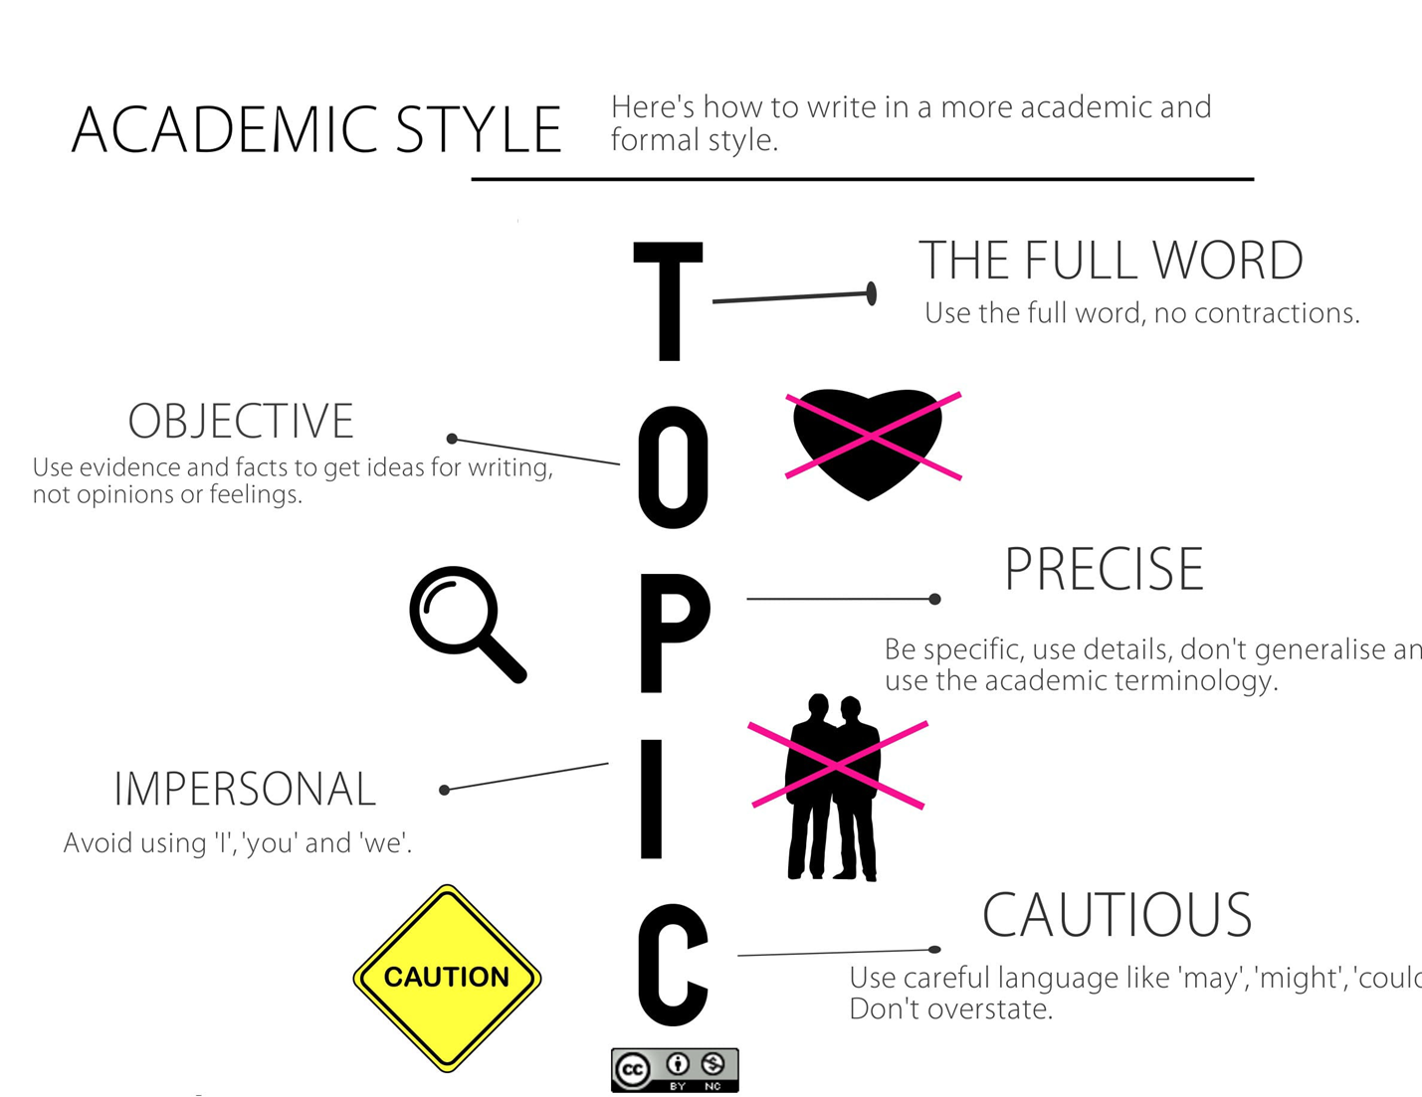

Slide 5
Dos
Be precise when dealing with facts or figures (many, a lot of)
Use tentative language in conclusions – cautious phrases
Use a statement instead of asking yourself a question. (Why did war break out in 1914?)
Use conjunctions and signposting expressions to introducing sections (Turning to the questions of detecting cancer, … )

Slide 6
Don’ts
“like” for introducing examples
“thing”, “nothing” or “something”
“lots of”, “little/big”, “good/bad”
“Get” phrases (get better) or “Make” phrases (make it happen)
Contractions (can’t, isn’t, should’ve, doesn’t)
* Personal pronouns (esp. I and you)

Slide 7
Don’ts
Phrasal verbs (“set up”, “go on”, etc.)
Conjunctions at the beginning of the sentence (“And”, “but”, “so”, etc.)
Idioms or colloquial vocabulary (“kids”, “boss”)
Adverbs expressing personal attitude (“luckily”, “surprisingly”)
Numbering and listing

Slide 8
Sentence revision 1
Another thing to think about is the chance of crime getting worse.
→ Another aspect of consideration is the possibility of crime becoming worse.

Slide 9
Sentence revision 2
Regrettably these days lots of people don’t have jobs.
→ Currently the rate of unemployment is high.

Slide 10
Sentence revision 3
Sometime soon people will find a vaccine for Covid-19.
→ In the near future a vaccine for Covid-19 may be discovered.

Slide 11
Sentence revision 4
You can’t always trust the numbers in that report.
→ The numbers in that report are unreliable.

Slide 12
Sentence revision 5
Years ago they allowed women to vote.
→ Women were enfranchised in 1987.

Slide 13
In-class writing – a mini-text analysis
Reading and understanding
Summary – the topic, the characters, the theme
Interpretation – the analysis of specific details & techniques
Evaluation – the effect and your comment.
Academic style

